Slide 1
Ethics in Information Technology
Chapter 2
Ethics for IT Workers and IT Users

Slide 2
Objectives
What key characteristics distinguish a professional from other kinds of workers, and is an IT worker considered a professional?
What factors are transforming the professional services industry?
What relationships must an IT worker manage, and what key ethical issues can arise in each?
How do codes of ethics, professional organizations, certification, and licensing affect the ethical behavior of IT professionals?
What is meant by compliance, and how does it help promote the right behaviors and discourage undesirable ones?

Slide 3
IT Professionals
Profession is a calling that requires:
Specialized knowledge
Long and intensive academic preparation
Professionals:
Require advanced training and experience
Must exercise discretion and judgment in their work
Their work cannot be standardized
Contribute to society, participate in lifelong training program, assist other professionals
Carry special rights and responsibilities

Slide 4
Are IT Workers Professionals?
Partial list of IT specialists
Programmers
Database administrators
Mobile application developers
Software engineers
Systems analysts
Network administrators

Slide 5
Are IT Workers Professionals? (cont’d)
Legal perspective
IT workers are not recognized as professionals as they
are not licensed by state or federal government
Are not liable for malpractice

Slide 6
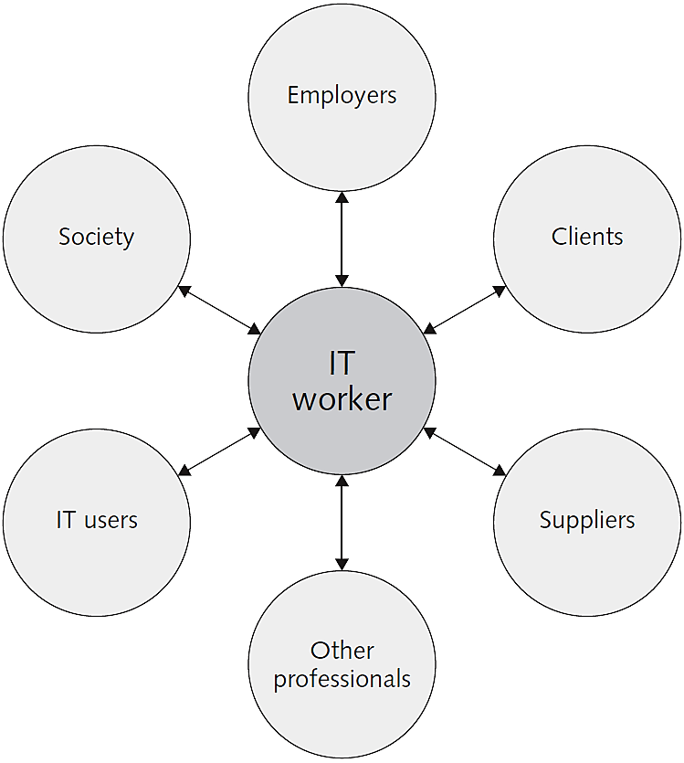
Professional Relationships That Must Be Managed

Slide 7
Relationships Between IT Workers and Employers
An IT worker and an employer typically agree on fundamental aspects of this relationship before the worker accepts an employment offer.
Other aspects of work relationship defined in company’s policy and procedure manual or code of conduct
As steward of organization’s IT resources, IT workers must set an example and enforce policies regarding the ethical use of IT

Slide 8
Relationships Between IT Workers and Employers (cont’d)
Software piracy
Act of illegally making copies of software or enabling access to software to which they are not entitled
Area in which IT workers can be tempted to violate laws and policies
Business Software Alliance (BSA) is a trade group representing the world’s largest software and hardware manufacturers.
Aims to stop the unauthorized copying of software

Slide 9
Relationships Between IT Workers and Employers (cont’d)
Trade secrets
Business information generally unknown to the public
Company takes actions to keep confidential
Require cost or effort to develop and have some degree of uniqueness or novelty
Whistle-blowing
Effort by an employee to attract attention to a negligent, illegal, unethical, or abusive act by a company that threatens the public interest

Slide 10
Relationships Between IT Workers and Employers (cont’d)
Students may be interested in the article UK workers would not blow the whistle on software piracy, which can be found here: http://www.infosecurity-magazine.com/view/20834/uk-workers-would-not-blow-the-whistle-on-software-piracy/
To learn more about the BSA, visit: http://www.bsa.org/GlobalHome.aspx
To learn more about trade secrets, visit: http://www.fbi.gov/news/stories/2010/september/steal-hybrid-technology

Slide 11
Relationships Between IT Workers and Clients
IT worker provides:
Hardware, software, or services at a certain cost and within a given time frame
Client provides:
Compensation, access to key contacts and work space
Relationship is usually documented in contractual terms

Slide 12
Relationships Between IT Workers and Clients (cont’d)
Client makes decisions about a project based on information, alternatives, and recommendations provided by the IT worker
Client trusts IT worker to act in client’s best interests
IT worker trusts that client will provide relevant information, listen to and understand what the IT worker says, ask questions to understand impact of key decisions, and use the information to make wise choices
Ethical problems arise if a company recommends its own products and services to remedy problems they have detected
Problems arise during a project if IT workers are unable to provide full and accurate reporting of a project’s status

Slide 13
Ethical Issues between IT Workers and Clients
Conflict of interest
A conflict between the IT worker’s self interest and the interests of the client
Fraud
Crime of obtaining goods, services, or property through deception or trickery
Misrepresentation
Misstatement or incomplete statement of material fact
If misrepresentation causes a party to enter into a contract, that party may have the right to cancel contract or seek reimbursement for damages.

Slide 14
Ethical Issues between IT Workers and Clients (cont’d)
Breach of contract
Occurs when one party fails to meet the terms of a contract
Material breach of contract
Occurs when a party fails to perform certain express or implied obligations, which impairs or destroys the essence of the contract
IT projects are joint efforts in which vendors and customers work together.
When there are problems, it is difficult to assign who is at fault

Slide 15
Relationships Between IT Workers and Suppliers
Develop good working relationships with suppliers:
To encourage flow of useful information and ideas to develop innovative and cost-effective ways of using the supplier in ways that the IT worker may not have considered
By dealing fairly with them
By not making unreasonable demands

Slide 16
Relationships Between IT Workers and Suppliers (cont’d)
Bribery
Providing money, property, or favors to someone in business or government in order to obtain a business advantage
U.S. Foreign Corrupt Practices Act (FCPA): Makes it a crime to bribe a foreign official, a foreign political party official, or a candidate for foreign political office
A bribe is not a crime if the payment was lawful under the laws of the foreign country in which it was paid.
United Nations Convention Against Corruption is a global treaty to fight bribery and corruption

Slide 17
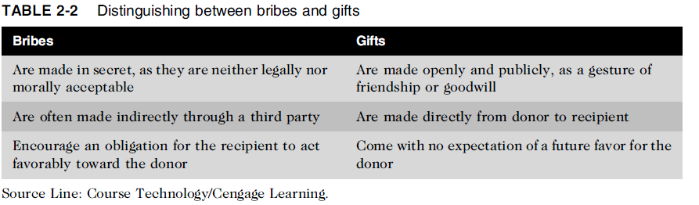
Relationships Between IT Workers and Suppliers (cont’d)

Slide 18
Relationships Between IT Workers and Other Professionals
Professionals owe each other adherence to their profession’s code of conduct
Ethical problems among the IT profession
Résumé inflation on 30% of U.S. job applications
Inappropriate sharing of corporate information
Information might be sold intentionally or shared informally with those who have no need to know

Slide 19
Relationships Between IT Workers and IT Users
IT user: person using a hardware or software product
IT workers’ duties
Understand users’ needs and capabilities
Deliver products and services that meet those needs
Establish environment that supports ethical behaviour:
To discourages software piracy
To minimize inappropriate use of corporate computing resources
To avoid inappropriate sharing of information

Slide 20
Relationships Between IT Workers and Society
Society expects members of a profession to:
Provide significant benefits
Not cause harm through their actions
Professional organizations provide codes of ethics to guide IT workers’ actions

Slide 21
Professional Codes of Ethics
State the principles and core values that are essential to the work of an occupational group
Most codes of ethics include:
What the organization aspires to become
Rules and principles by which members of the organization are expected to abide
A commitment to continuing education for those who practice the profession

Slide 22
Professional Codes of Ethics (cont’d)
Following a professional code of ethics can produce benefits for the individual, the profession, and society as a whole
Ethical decision making
High standards of practice and ethical behavior
Trust and respect from general public
Evaluation benchmark for self-assessment

Slide 23
Professional Organizations
No universal code of ethics for IT professionals
No single, formal organization of IT professionals has emerged as preeminent
The most prominent organizations include:
Association for Computing Machinery (ACM)
Institute of Electrical and Electronics Engineers Computer Society (IEEE-CS)
Association of IT Professionals (AITP)
SysAdmin, Audit, Network, Security (SANS) Institute

Slide 24
Professional Organizations (cont’d)
To learn more about the SANS Institute, please visit:
http://www.sans.org/
Point out that the mission of the AITP differs from that of the ACM, as the AITP puts more emphasis on leadership and education.
The AITP:
http://www.aitp.org/
Compare the ACM and the AITP to the IEEE, noting that IEEE includes a wide number of professions and provides a variety of services to each.
The IEEE-CS:
http://www.computer.org/portal/site/ieeecs/index.jsp
The ACM:
http://www.acm.org

Slide 25
Certification
Certification indicates that a professional possesses a particular set of skills, knowledge, or abilities in the opinion of the certifying organization
Can also apply to products
Generally voluntary
May or may not require adherence to a code of ethics
Employers view as benchmark of knowledge
Opinions are divided on value of certification

Slide 26
Certification (cont’d)
Vendor Certifications
Many IT vendors such as Cisco, IBM, Microsoft, SAP, and Oracle offer certification
Programs for those who use their products.
Some certifications substantially improve IT workers’ salaries and career prospects
Relevant for narrowly defined roles or certain aspects of broader roles
Require passing a written exam, or in some cases, a hands-on lab to demonstrate skills and knowledge
Can take years to obtain necessary experience
Training can be expensive

Slide 27
Certification (cont’d)
Industry association certifications
Require a higher level of experience and a broader perspective than vendor certifications
Must sit for and pass written exam
May need to pay annual renewal fee, earn continuing education credits, and/or pass renewal test
Lag in developing tests that cover new technologies
Are moving from purely technical content to a broader mix of technical, business, and behavioral competencies

Slide 28
Government Licensing
Government license: permission to engage in an activity or operate a business
Generally administered at the state level in the United States
Often requires that recipient pass a test
Some professionals must be licensed – doctors, lawyers, CPAs, medical and day care providers, engineers
One goal: protect public safety

Slide 29
Government Licensing (cont’d)
Case for licensing IT workers
Encourages following highest standards of profession
Encourages practicing a code of ethics
Violators would be punished
Without licensing, there are no requirements for heightened care and no concept of professional malpractice

Slide 30
Government Licensing (cont’d)
Issues associated with government licensing of IT workers
There are few licensing programs for IT professionals
No universally accepted core body of knowledge
Body of knowledge: Outlines agreed-upon sets of skills and abilities that all licensed professionals must possess
Unclear who should manage content and administration of licensing exams
No administrative body to accredit professional education programs
No administrative body to assess and ensure competence of individual workers

Slide 31
IT Professional Malpractice
Negligence: not doing something that a reasonable person would do, or doing something that a reasonable person would not do
Duty of care: obligation to protect people against any unreasonable harm or risk
Reasonable person standard
Reasonable professional standard
Professional malpractice: professionals who breach the duty of care are liable for injuries that their negligence causes

Slide 32
Common Ethical Issues for IT Users
Employees’ ethical use of IT is an area of growing concern because of increased access to: personal computers, corporate information systems and data and the Internet.
Software piracy
Popularity of the Android smartphone operating system has contributed to the software piracy problem
Inappropriate use of computing resources
Erodes productivity and wastes time
Could lead to lawsuits

Slide 33
Common Ethical Issues for IT Users (cont’d)
Inappropriate sharing of information, including:
Every organization stores vast amounts of private or confidential data
Private data (employees and customers)
Confidential information (company and operations)

Slide 34
Supporting the Ethical Practices of IT Users
Policies that protect against abuses:
Set forth general rights and responsibilities of users
Create boundaries of acceptable behaviour
Enable management to punish violators
Policy components include:
Establishing guidelines for use of company software
Defining appropriate use of IT resources
Structuring information systems to protect data and information
Installing and maintaining a corporate firewall

Slide 35
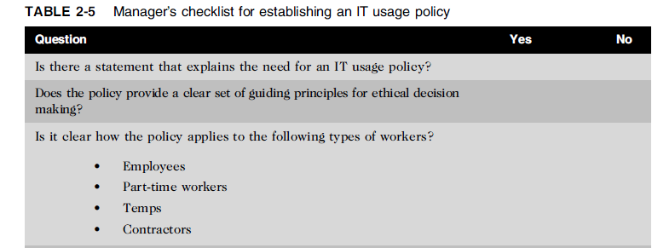
Supporting the Ethical Practices of IT Users (cont’d)

Slide 36
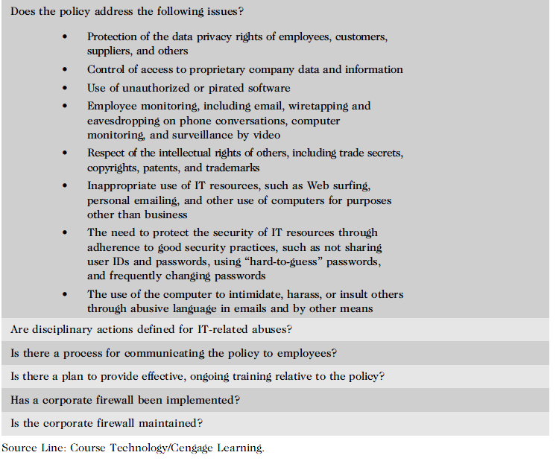
Supporting the Ethical Practices of IT Users (cont’d)

Slide 37
Compliance
Compliance means to be in accordance with established policies, guidelines, specifications, and legislation
Sarbanes-Oxley established requirements for internal controls
HIPAA ensures security and privacy of employee healthcare data
Failure to be in conformance can lead to criminal or civil penalties and also lawsuits

Slide 38
Compliance (cont’d)
Major challenge to comply with multiple government and industry regulations that are sometimes in conflict
To ensure compliance, companies:
Implement software to track and record compliance actions
Hire management consultants for advice and training
Create the position of chief compliance officer (CCO), to deal with the issues related to compliance

Slide 39
Compliance (cont’d)
Audit committee is subset of the board of directors, with oversight for the following activities:
Quality and integrity of accounting and reporting practices and controls
Compliance with legal and regulatory requirements
Qualifications, independence, and performance of organization’s independent auditor
Performance of company’s internal audit team

Slide 40
Compliance (cont’d)
Internal audit committee responsibilities:
Determine that internal systems and controls are adequate and effective
Verify existence of company assets and maintain proper safeguards over their protection
Measure the organization’s compliance with its own policies and procedures
Ensure that institutional policies and procedures, appropriate laws, and good practices are followed
Evaluate adequacy and reliability of information available for management decision making

Slide 41
Summary
Professionals
Require advanced training and experience
Must exercise discretion and judgment in their work
Their work cannot be standardized
From a legal standpoint, a professional:
Has passed the state licensing requirements
Has earned the right to practice in a state(s)
IT professionals have many different relationships
Each with its own ethical issues and potential problems

Slide 42
Summary (cont’d)
Professional code of ethics
States the principles and core values essential to the work of an occupational group
Serves as a guideline for ethical decision making
Promotes high standards of practice and behavior
Enhances trust and respect from the general public
Provides an evaluation benchmark
Licensing and certification of IT professionals
Would increase the reliability and effectiveness of information systems
Raises many issues

Slide 43
Summary (cont’d)
IT-related professional organizations have developed their code of ethics that:
Outlines what the organization aspires to become
Lists rules and principles for members
Includes a commitment to continuing education for those who practice the profession
Audit committee and internal audit team have a major role in ensuring that both the IT organization and IT users are in compliance with guidelines and various legal and regulatory practices

Slide 44
Reference
Ethics in Information Technology, George W. Reynolds, Fifth Edition

